Slide 1



Engineering Economics| ME 2001 | 3 Credits | 3 0 0 3
Lecture 3-4
Theory of demand and supply analysis
Course Instructor Dr. Vijay S. Kumawat
Assistant Professor, Department of Mechanical Engineering
Engineered Biomedical Materials Research and Innovation Centre (EnBioMatRIC)
School of Automobile, Mechanical and Mechatronics Engineering (SAMME)
Manipal University Jaipur
Ph: +91-9001225135
Email: vijayshankar.Kumawat@jaipur.manipal.edu
: https://scholar.google.com/citations?user=3g9gCscAAAAJ&hl=en
: https://www.linkedin.com/in/vijay-shankar-kumawat-24a02a195
Website: https://www.jaipur.manipal.edu
https://www.enbionac.in/

Slide 2



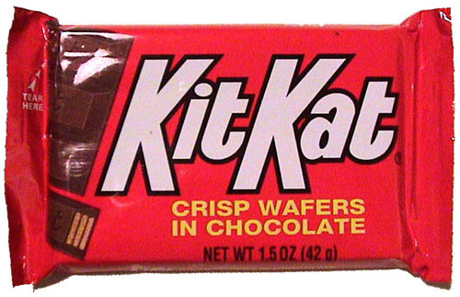


Nature of Demand
Lecture 2
The desire, ability, and willingness to buy a product or service
Desire? Ability? Willingness?

Slide 3
Nature of Demand
Lecture 2
Desire
There are three important points to remember about the quantity demanded:
First, the quantity demanded is the quantity desired to be purchased. It is the desired purchase. The quantity actually bought is referred to as actual purchase.
Secondly, quantity demanded is always considered as a flow measured over a period of time.
if the quantity demanded of oranges is 10, it must be per day or per week, etc.
Thirdly, the quantity demanded will have an economic meaning only at a given price.
For example, the demand for oranges equal to 10 units per week at a price of Rs. 100 per dozen is a full and meaningful statement, as used in micro-economic theory.
Desire is just a wish on the part of the consumer to possess a commodity.
Want
If the desire to take a commodity is backed by the purchasing power and the consumer is also willing to buy that commodity, it becomes want.
Demand
Demand is the wish of the consumer to get a definite quantity of a commodity at a given price in the market backed by a sufficient purchasing power.

Slide 4
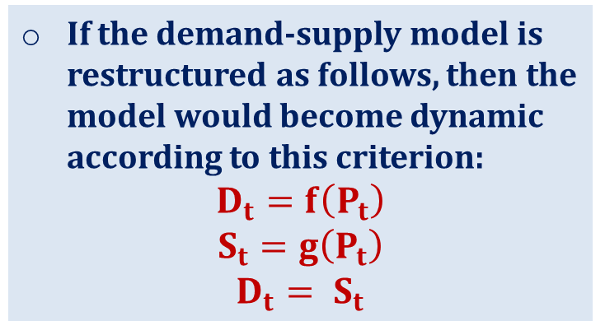
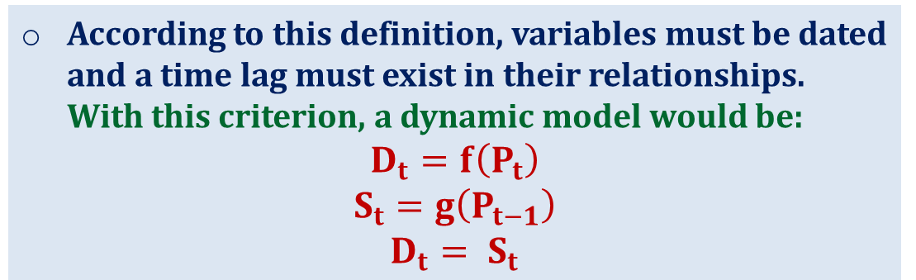
Economic Analysis
Lecture 2
Variables are not dated
Economic Analysis
Dynamic model
Static
model
The demand-supply model of market behaviour is a static model.
Static Model
In this model, demand depends on own price, supply depends on own price, with an equilibrium condition that demand must equal supply, time does not enter into the picture at all and the variables are all undated.
Variables are dated
According to some economists, even if the variables are dated the model does not become dynamic.
If the demand-supply model is restructured as follows, then the model would become dynamic according to this criterion:
$$D_{t}=f\left(P_{t}\right)$$
$$S_{t}=g\left(P_{t}\right)$$
$$D_{t}= S_{t}$$
According to this definition, variables must be dated and a time lag must exist in their relationships. With this criterion, a dynamic model would be:
$$D_{t}=f\left(P_{t}\right)$$
$$S_{t}=g\left(P_{t−1}\right)$$
$$D_{t}= S_{t}$$
Dynamic Model
Where, ‘t’ is the relevant time unit.
Notes:
There is no lag in the demand relationship. Demand in period ‘t’ depends on
own price of the same period. However, in the supply relationship a gestation
lag exists which makes the model dynamic. Supply in period ‘t’ depends on
price prevailing in the previous period (t–1). The price level in previous period
(t–1) would have induced the producers to increase or decrease the supply, full
impact of such decisions are visible in time period ‘t’ only.

Slide 5
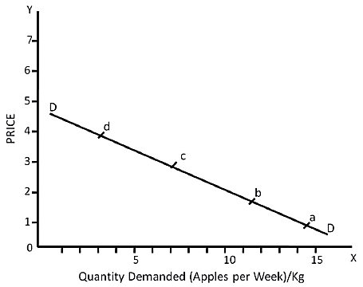
Law of Demand
Lecture 2
The inverse relationship between the quantity of a commodity and its price, given all other factors that influence the demand is called ‘law of demand’.
It gives us a demand curve that slopes downwards to the right. We can explain this idea with help of a demand schedule
Demand curve
The demand curve graphically shows the relationship between the quantity of a good that consumers are willing to buy and the price of the good.
Price of Apple per Kg. (in Rs.) | Quantity Demanded of Apples (in Kg. per week)
100 | 15
200 | 12
300 | 8
400 | 3

Slide 6
Determinants of Demand by a Consumer
Lecture 2
The demand for commodity is dependent on a number of factors. These are mentioned as follows:
1
Price of the commodity: Normally, higher the price of the commodity, the lower the demand of the commodity. This is the law of demand.
Price Per CD | # of CDs Demanded
$1 | 300
$2 | 162
$3 | 94
$4 | 58
$5 | 37
$6 | 25
$10 | 18
$15 | 13
$20 | 10
30
25
20
15
10
5
0
0
100
200
300

Slide 7
Determinants of Demand by a Consumer
Lecture 2
Law of demand.
P= Price QD= Quantity Demanded
P⬆ QD⬇
P⬇ QD ⬆
Price
P2
P1
QD2
QD1
Quantity Demanded

Slide 8
Determinants of Demand by a Consumer
Lecture 2
Size of consumers income/ Buyer’s income: When the increase in income leads to an increase in the quantity demanded, the commodity is called a ‘normal good’. If an increase in income leads to a fall in the quantity demanded, we call that commodity an ‘inferior good’.
2
Income ⬆ Demand⬆
Income ⬇ Demand⬇
Examples:
Minimum wage increases
Economic Recession
The Great Depression

Slide 9












Determinants of Demand by a Consumer
Lecture 2
Prices of other related commodities: A consumer’s demand for a commodity may also be influenced by the prices of some other commodities. Some are complementary goods, which are consumed along with the commodity, while others may be used in place of this commodity. This category is called substitutes.
3

Slide 10
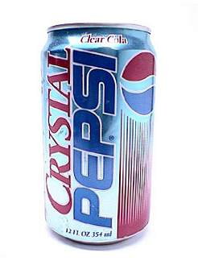



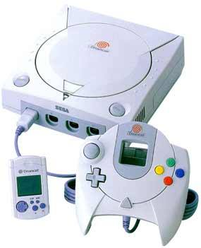

Determinants of Demand by a Consumer
Lecture 2
Taste of the consumers: If a consumer has developed a taste for a particular commodity, he/she will demand more of that commodity. Similarly, if a consumer has changed his taste against a particular commodity, less of it will be demanded at any particular price. This development of tastes may be related to seasons of the year as well.
4

Slide 11
Why does a Demand Curve Slope Downwards?
Lecture 2
Substitution Effect: Substitution effect results from a change in the relative price of a commodity.
Suppose a Pepsi Can and a Coke Can both are priced at Rs. 90 and Rs. 20 each. If the price of Coke is raised to Rs. 25, and the price of Pepsi is not changed, Pepsi will become relatively cheaper to Coke, i.e. although the absolute price of Pepsi has not changed, the relative price of Pepsi has gone down.
The change in the relative price of commodity causes substitution effect.
Income Effect: This is the effect of a change in total purchasing power of the money income of the consumer.
As price of mango falls the purchasing power of the given money income rises, or his real income rises. Thus, he can buy more of the mangoes with the same money income.
His demand for any other commodities may also rise. This is called the ‘income effect’.
It is important to note that substitution effect and income effect operate simultaneously with the change in the price of the commodity.
‘Substitution effect’, and ‘income effect’ taken together give ‘price effect.’
Price Effect: Price Effect is the sum total of the substitution effect and income effect, i.e.
PE = SE + IE
Where PE = Price Effect.
SE = Substitution Effect
IE = Income Effect

Slide 12
Determinants of Market Demand
Lecture 2
The factors determining the demand for a commodity in a market are the same as those which determine the demand for the commodity on the part of a consumer.
Besides that two additional factors are also to be included. These two factors are:
Size of the population: All other factors remaining unchanged, the greater is the size of the population, more of a commodity will be demanded.
Income distribution: : People in different income groups show marked differences in their preferences. So if larger share out of national income goes to the rich, demand for the luxury goods may rise and a rise in income share of the poor will increase demand for the wage goods.

Slide 13
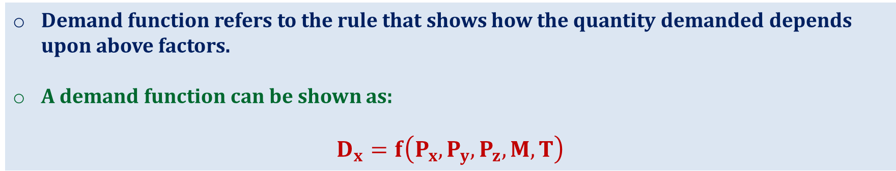
Determinants of Demand by a Consumer
Lecture 2
Demand function refers to the rule that shows how the quantity demanded depends upon above factors.
A demand function can be shown as:
$$D_{x}=f\left(P_{x},P_{y},P_{z}, M, T\right)$$
where,
Dx is quantity demanded of X commodity
Px is the price of X commodity
Py is the price of substitute commodity
Pz is price of a complement good
M stands for income
T is the taste of the consumer
If all the factors influencing the demand for a commodity X vary simultaneously, the picture would be highly complicated.
Therefore, normally we allow only one of the factors to change, assuming that all other factors remain unchanged

Slide 14


Engineering Economics
Lecture 2
Engineering economics deals with the methods that enable one to take economic decisions towards minimizing costs and/or maximizing benefits to business organizations.
Key points
Produce goods/services depending on physical law
Example: Technical efficiency of a diesel engine is less than 100%.
This is mainly due to frictional loss and incomplete combustion of fuel
Physical environment
$$Technical Efficiency=\frac{System Output}{System Input}$$
Technical efficiency can never be more than 100%.
Engineering
Worth: Annual revenue generated by way of operating the business.
Cost: Total annual expenses incurred in carrying out the business.
For the survival and growth of any business, the economic efficiency should be more than 100%.
Economic environment
Assessing the worth of these products in economic terms
$$Economic Efficiency=\frac{System Worth}{System Cost}$$

